Slide 1
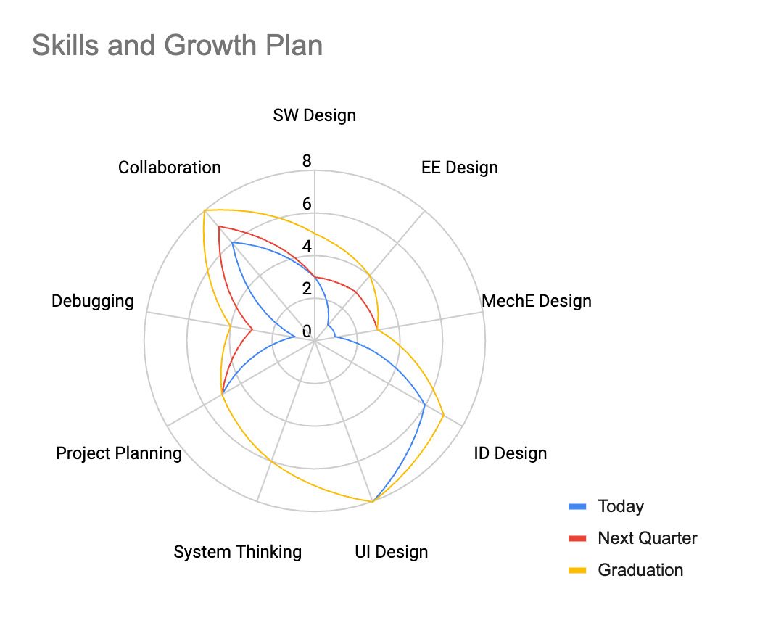
[Name (and any tips for pronunciation)]
Before this program my academic/professional/personal background is primarily :
[your answer here]
After this program I hope to be …
[your answer here]
For this class, I am most interested to learn more about :
[your answer here]
For this class, I am most anxious about my skills in :
[your answer here]
Picture of your face that we can recognize you from

